Slide 1
JJS and Associates
Introduction To Bitcoin Mining

Slide 2
A History
JJS and Associates was founded in 2018 by Sean Cox, Jim Heaton, and Joe Pearce
JJS and Associates operates independently under iThink Global Technologies, founded in 2013, by Sean Cox, formerly known as Cox Global Enterprises (2009)
Following Years of research the decision to form JJS and Associates was made and plans to become the largest cryptocurrency mining company in the United States.

Slide 3
Examples of Miners:
The ASGMINT PROF 2.0 is a new model developed for large miners and crypto-currency farms
It is the second generation model
It uses SHA256 protocol
Hash rate is 366,85 Th/s
Power consumption is 8591 W/hr
Each miner has a capacity of 132 GH.
There are 58 boards inside the miner with 48 chips on each board, with each able to run autonomously.
These can operated in any mining pool

Slide 4
Miner Examples Continued:
Asicboost support is not needed
56 high-speed cooling fans are running at top-speed to provide adequate cooling.
The miner uses three independent built-in power supplies (3 Kw each), connected through a special current divider.
All power supplies have their own fan.
To display system errors, a system with LED’s (one LED per board) is used.
They are guaranteed for one year

Slide 5
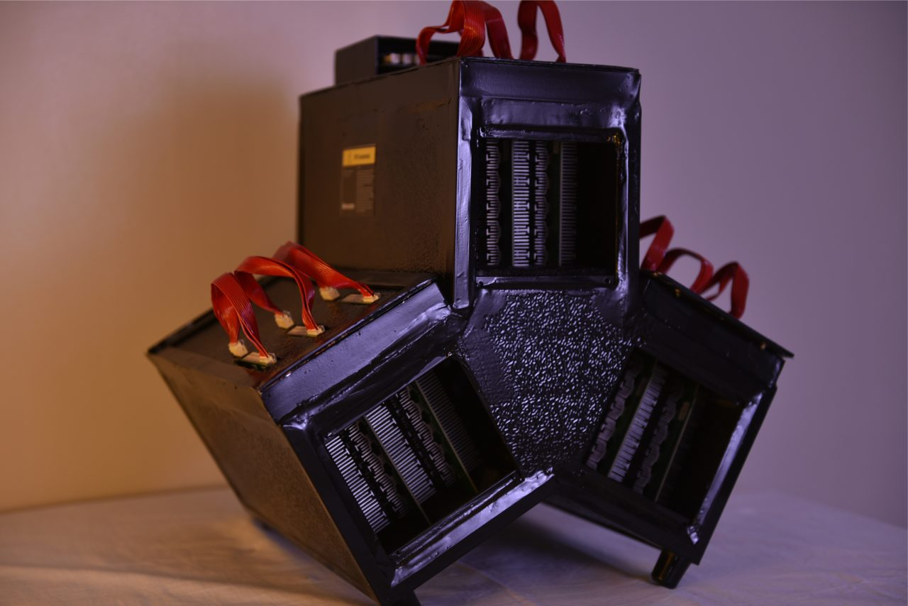
Back View of AsIC Miner

Slide 6
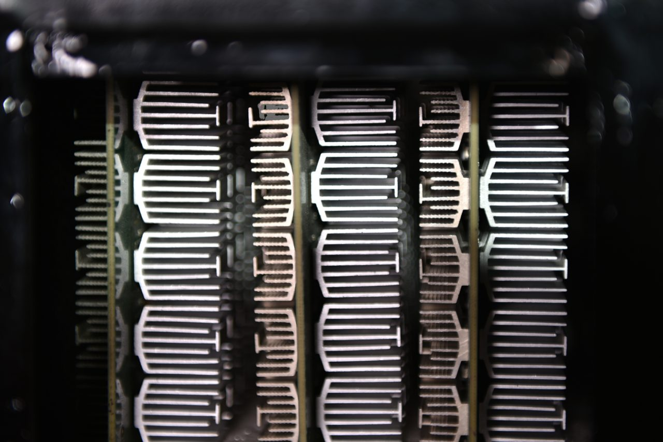
ASIC Hashing Board

Slide 7
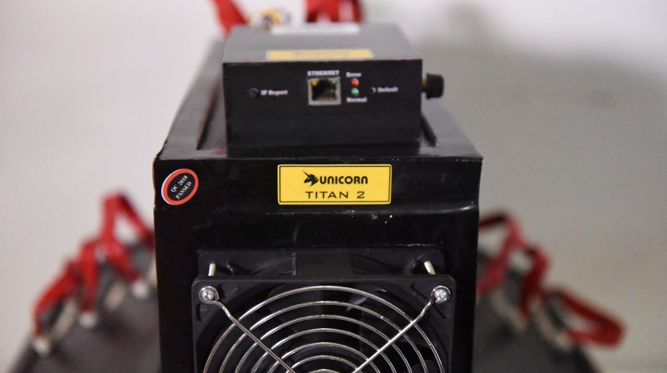
Unicorn

Slide 8
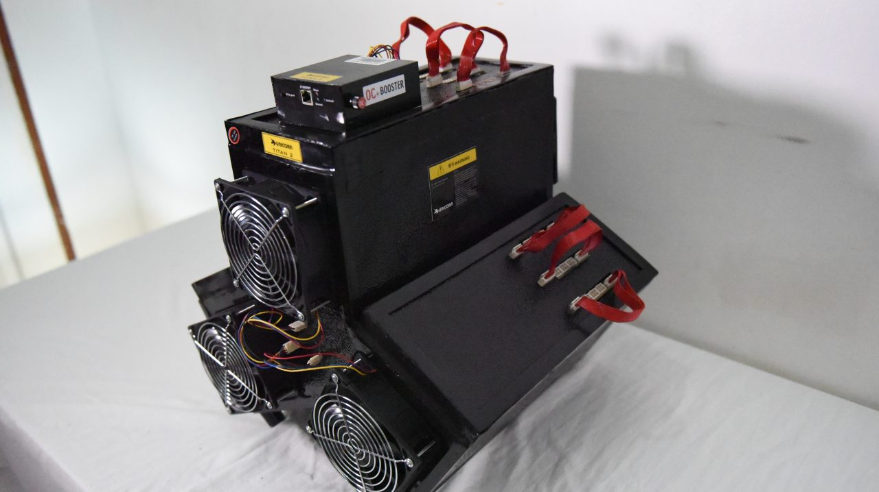
Miners

Slide 9
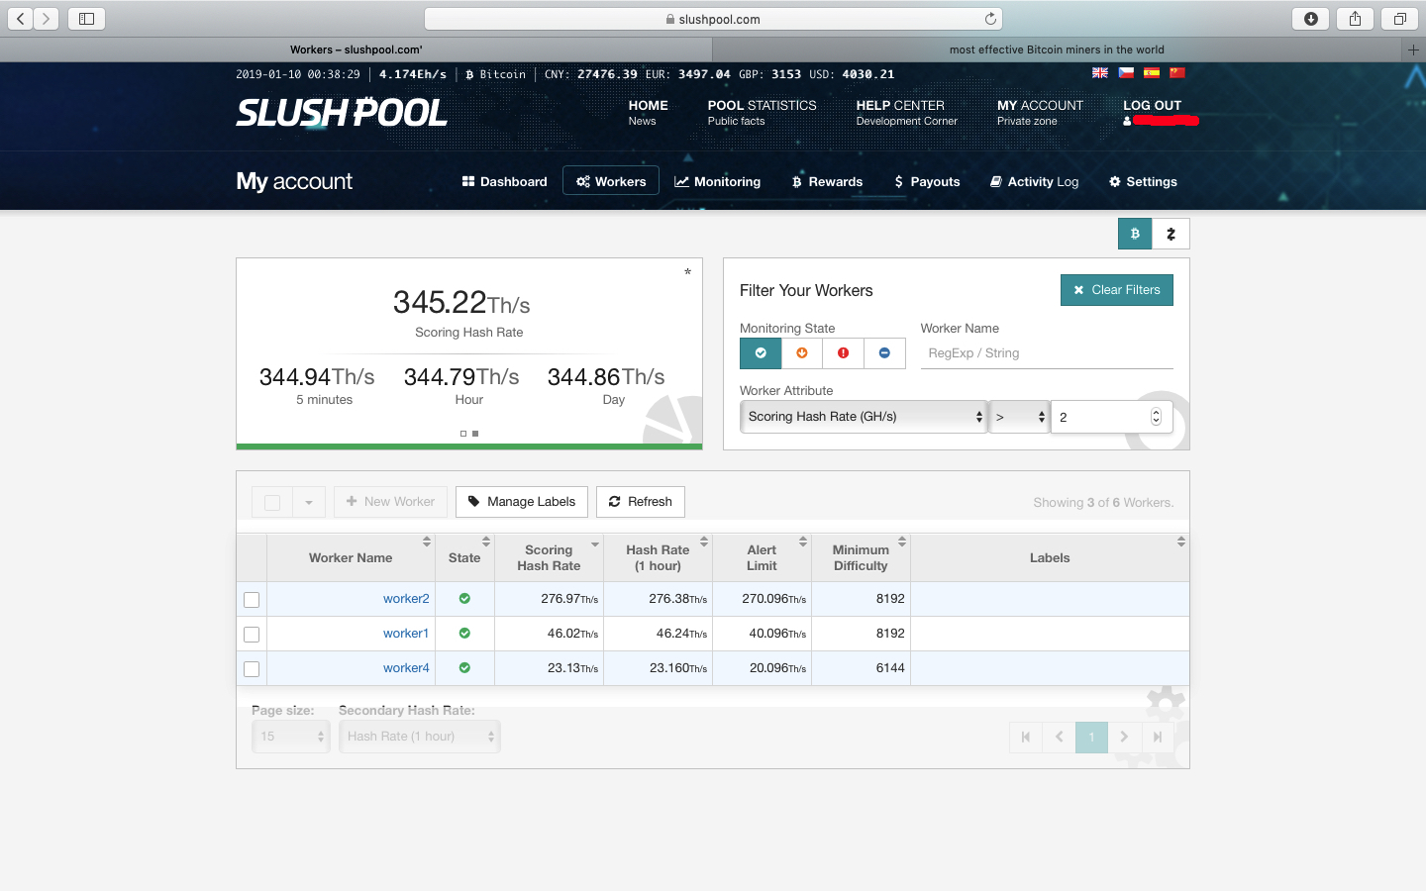
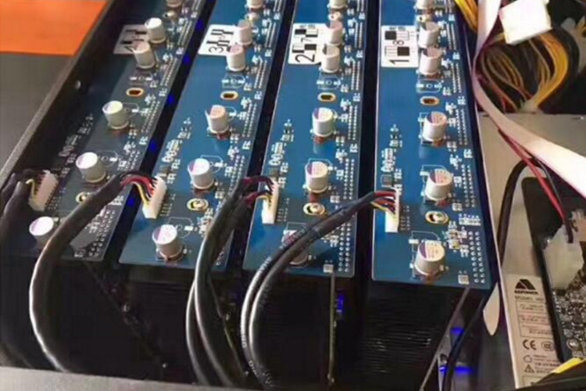
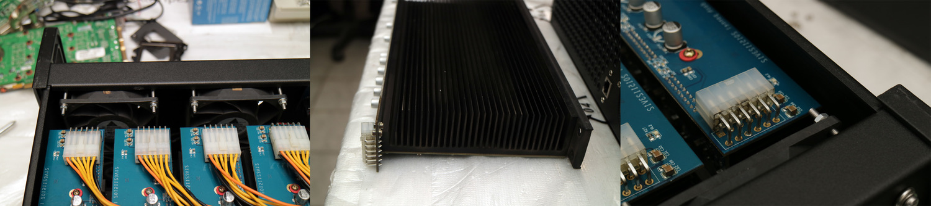
Chipset main boards

Slide 10
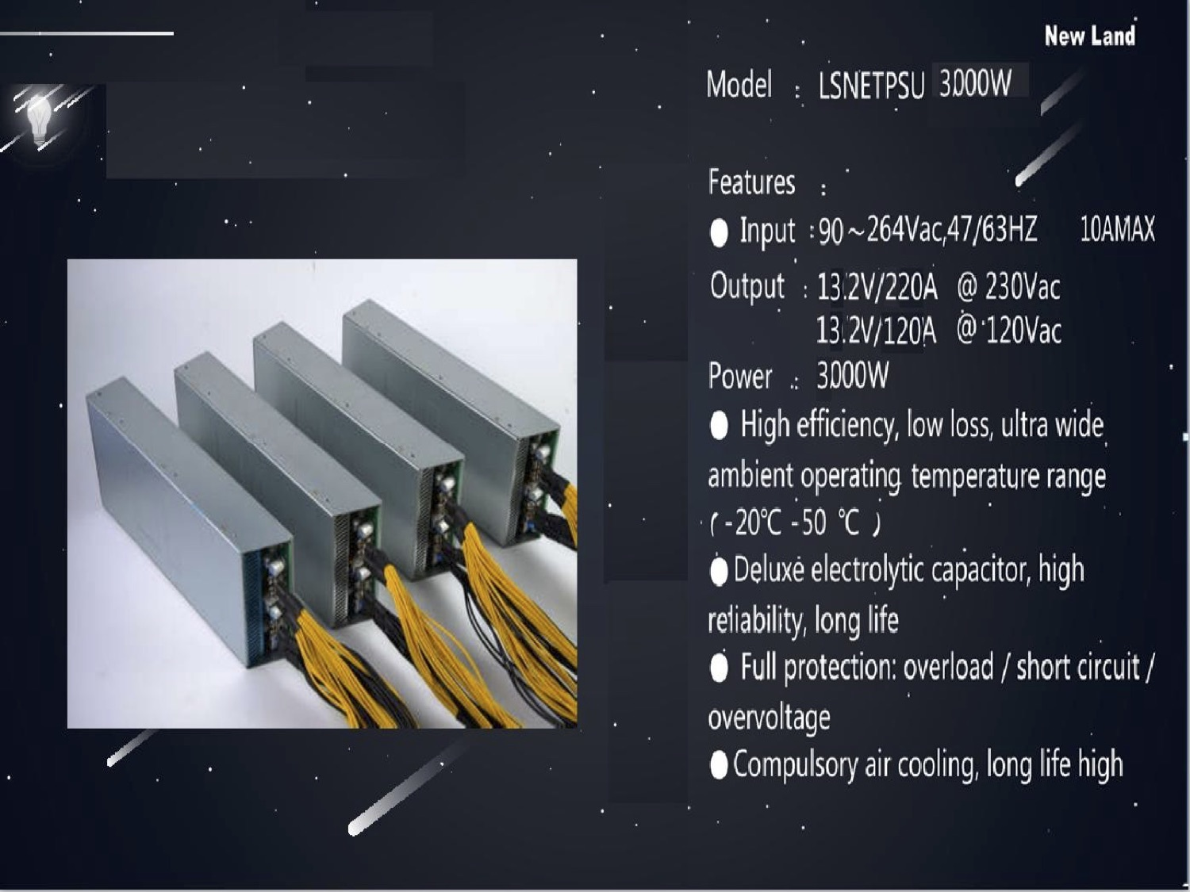
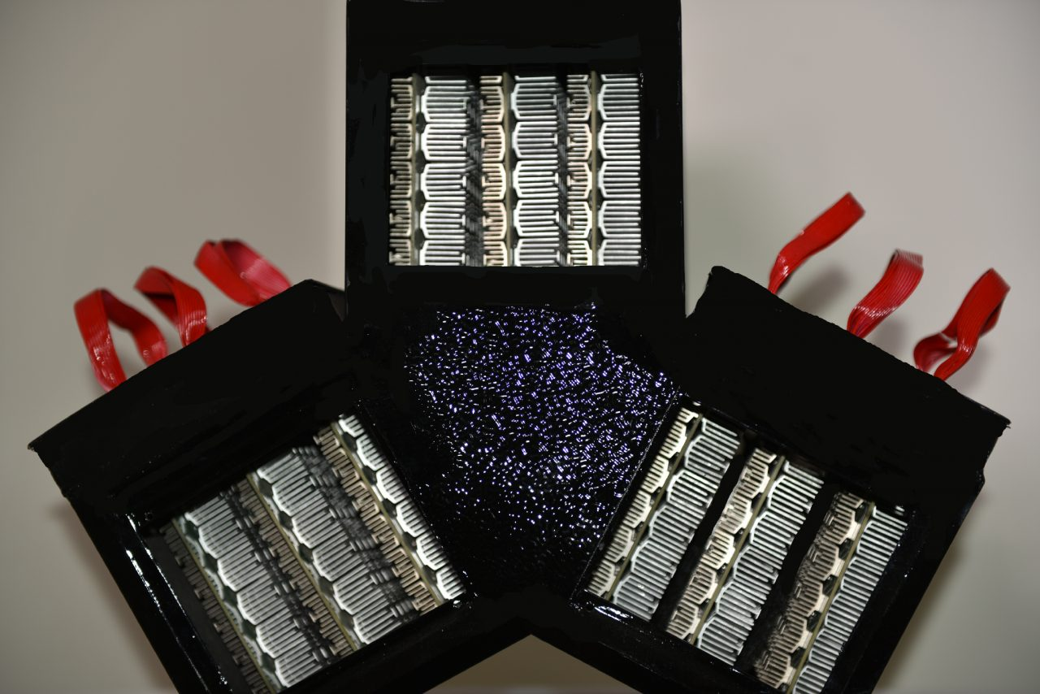
Power supply and cooling fins

Slide 11
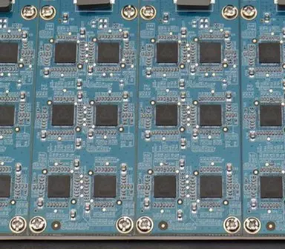
Professional Chipset

Slide 12
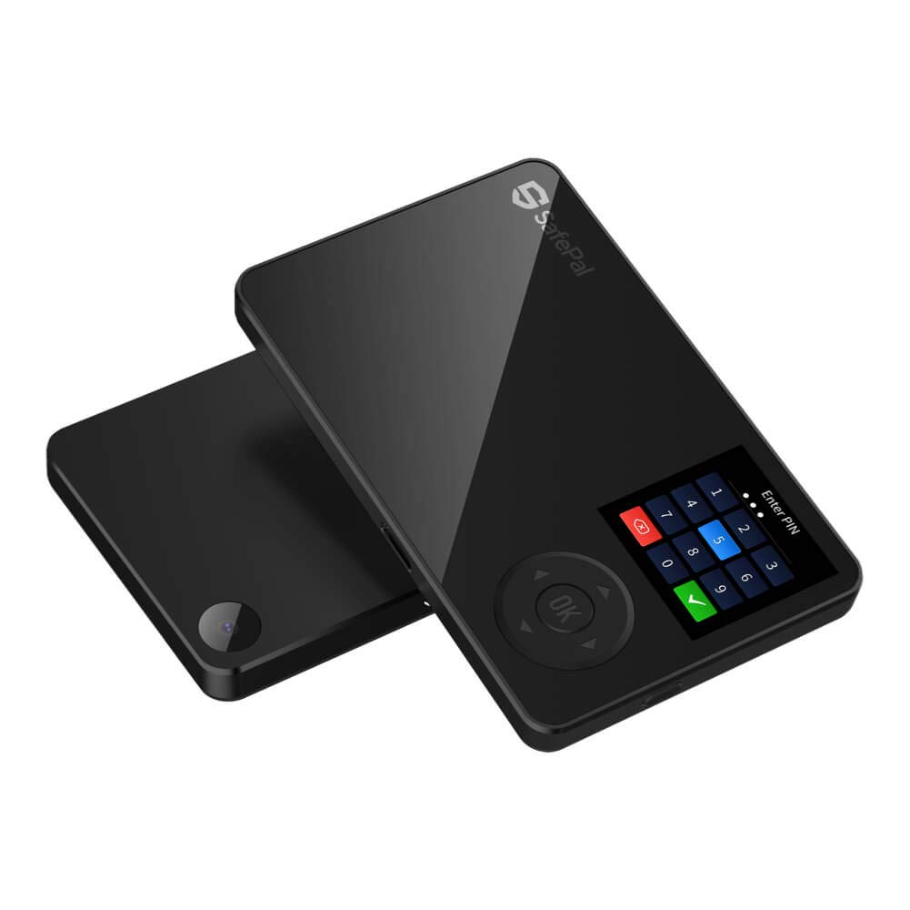
Cold Storage Wallet – Keeping Your Crypto Currency Safe

Slide 13
How does cold storage work?
It is the safest way to securely store your crypto currency.
Your crypto currency can not be copied, scanned, or stolen when kept in cold storage. The only way you can lose data is if your cellphone and cold storage device are stolen. This is called 2 FA authentication. If someone takes your storage device, and you have your cellphone, you can safely rebuild your crypto onto a new device, and then the old one is erased automatically.
cold storage devices vary on security level as well as by design

Slide 14
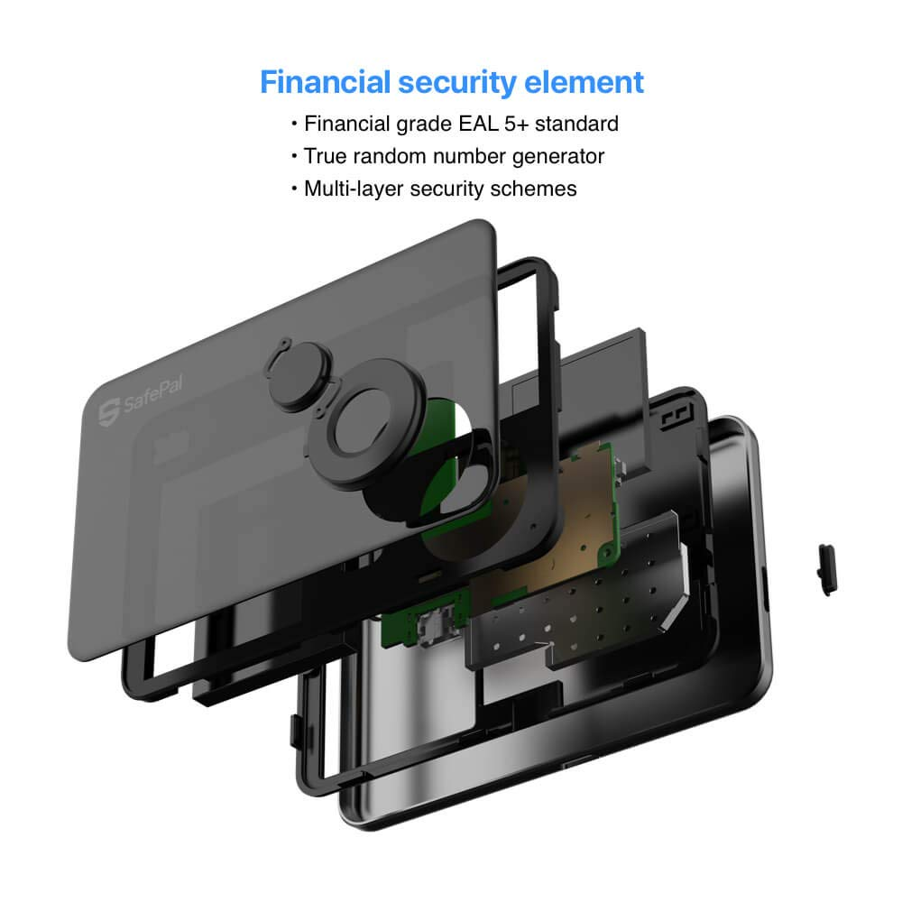
Cold Storage Continued

Slide 15
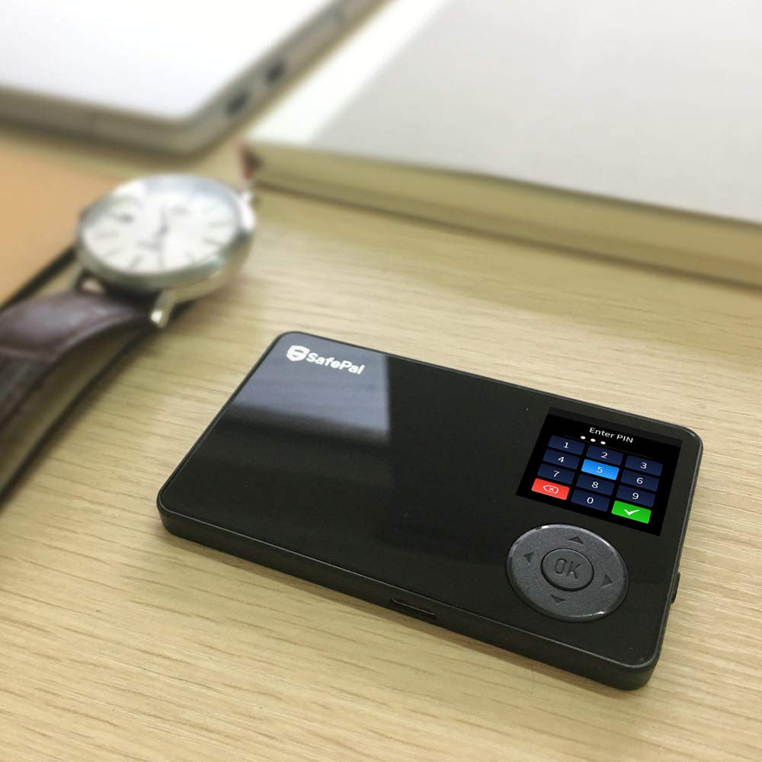
Cold Storage – Easy To Carry Size And convenience

Slide 16
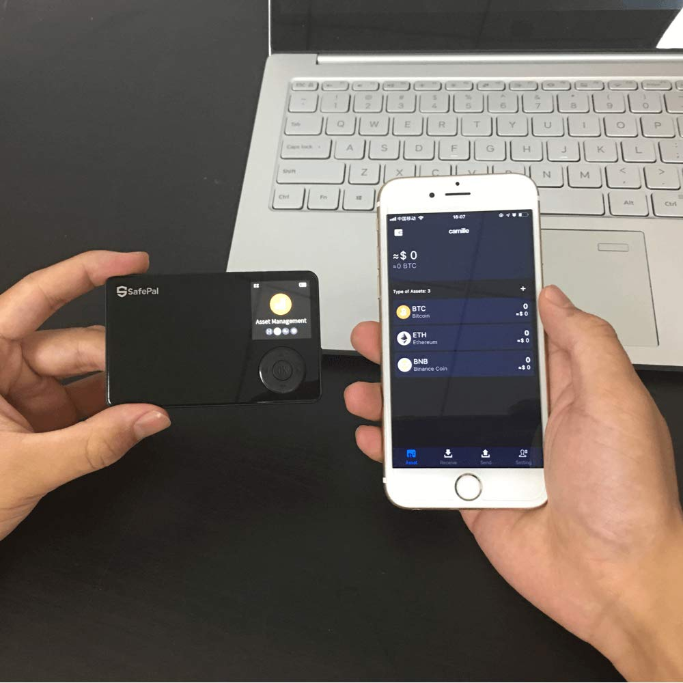
Cold Storage use it wherever visa is accepted and spend bitcoin, not traditional money

Slide 17
What is the world doing with crypto currency?
Bitcoin mining tends to gravitate towards countries with cheap electricity.
As Bitcoin mining is somewhat centralized, 10-15 mining companies have claimed the vast majority of network hash power.
With many of these companies in the same country, only a number of countries mine and export a significant amount of bitcoins.

Slide 18
CHINA
China mines the most bitcoins and therefore ends up “exporting” the most bitcoins.
Electricity in China is very cheap and has allowed Chinese Bitcoin miners to gain a very large percentage of Bitcoin’s hash power.
It’s rumored that some Chinese power companies point their excess energy towards Bitcoin mining facilities so that no energy goes to waste.
China is home to many of the top Bitcoin mining companies:
F2Pool, AntPool, BTCC, and BW.
It’s estimated that these mining pools own somewhere around 60% of Bitcoins hash power, meaning they mine about 60% of all new bitcoins.

Slide 19
GEORGIA, SWEDEN, and the united states
Georgia is home to BitFury, one of the largest producers of Bitcoin mining hardware and chips. BitFury currently mines about 15% of all bitcoins.
Sweden is home to KnCMiner, a Bitcoin mining company based in Stockholm. KnCMiner currently mines about 7.5% of all bitcoins.
The US is home to 21 Inc., a Bitcoin mining company based in California.
21 runs a large amount of miners, but also sells low powered bitcoin miners as part of their 21 Bitcoin computer.
Most of the hash power from the 21 Bitcoin computers is pointed towards 21’s mining pool. 21 Inc. mines about 3% of all bitcoins.
These countries account for 80% of the mining pool, with the remaining 20% spread across the globe.

Slide 20
BITCOIN ADDRESSES
More than 11 million such addresses have between ₿0.001 to 0.1 bitcoin, worth between $10 to $1,000.
Some 8 million addresses have $100 or more of bitcoin. So about 10 million have $1-$10 of bitcoin and 3 million have $10 to $100.
Bitcoin distribution according to Bitinfo, Sep 2019
There are some bitcoin millionaires with 15,000 addresses having between $1 million and $10 million or more.

Slide 21
BITCOIN ADDRESSES
Just circa half a million addresses have around one bitcoin, with most wealth concentrated in addresses that have between ₿1,000 – ₿10,000 coins.
That may be due to cold wallets which some exchanges, like coinbase, chop into chunks of ₿5,000 or ₿10,000.
Quite a bit of wealth is also concentrated in addresses that have between ₿10 – ₿100 coins, with addresses that have between ₿10 – ₿10,000 accounting for some 70% of the bitcoin wealth.
That’s in total about 150,000 addresses, with one address able to hold funds that belong to many individuals, just as many addresses can belong to one individual.

Slide 22
BITCOIn addresses
So it isn’t very easy to discern wealth distribution from the above data because many just keep their coins on exchanges with a number of the top addresses being exchanges.
Top bitcoin addresses, Sep 2019
All of the addresses that control more than 100,000 bitcoin belong to exchanges, with a big address in general more likely to belong to an exchange or service provider.
Addresses that have 1 – 100 bitcoin, on the other hand, are probably ordinary individuals with about one million such addressees accounting for some 35% of the total wealth.
Making bitcoin a lot more distributed than it used to be and far more distributed than other cryptos where wealth in general is significantly more concentrated.

Slide 23
What We are poised to do in the united states
We are poised to grow faster than any other crypto mining farm. Due to our location, the cost of power, and the land already involved, we are poised to start, where other companies need a few years to get where we are. We are also able to tap into natural resources to help reduce the cost of power even more.
Our long term goal is to make the USA number one instead of number six on a global list of countries that use and/or trade crypto currencies. Currently China controls 28.7 % of the global mining pools, whereas Russia controls 23% and then down the list is the USA at 12%. We can take the USA and bring it up to 38%.

